Slide 1
Mining Git
How to automate my activities in git

Slide 2
Feature C
Feature B
Feature A
Base Commit
Merge Commit

Slide 3
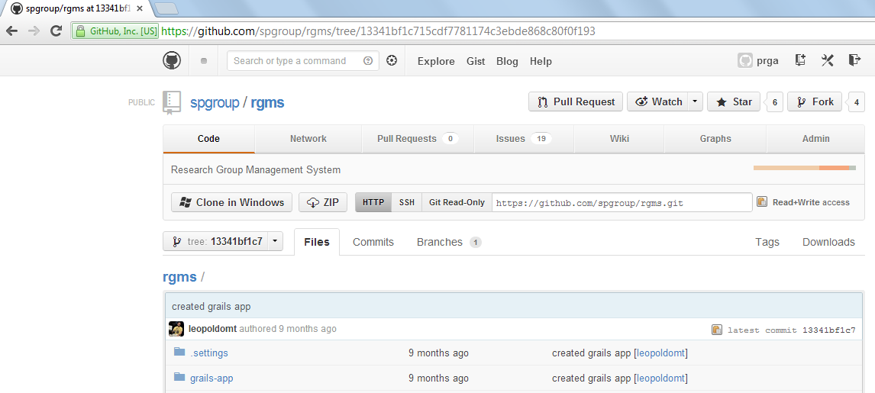
Download Zipped Commits from GitHub

Slide 4



1st step: download and unzip commits
GIT
Base
Feature A
…
Feature B

Slide 5
2nd step: compute features changesets from base commit
________
Feature A
Changeset A
________
Base
Feature B
Changeset B
…
________
Feature N
Changeset N

Slide 6
3rd step: compute features changesets intersection
For features A, B and C:
________
________
=
________
U
Changeset A
Changeset B
A ^ B
________
U
________
=
________
Changeset A
Changeset C
A ^ C
________
U
________
=
________
Changeset B
Changeset C
B ^ C

Slide 7
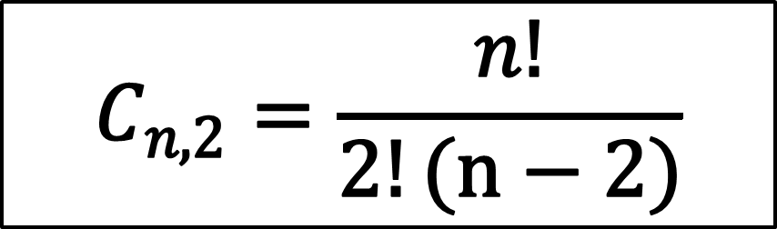
Formula for calculating the intersection for n features
$$C_{n,2}=\frac{n!}{2!(n−2)}$$

Slide 8

At the end we’ll have all a list of files that were changed in parallel by developers implementing different feature, that is, potential conflicts
F1
F2
System

Slide 9
Algorithm that computes the changeset from a base commit

Slide 11

Step-by-step
Download zipped commit
Unzip commit
Load files from an directory and its subdirectories
Compute differences between code assets
Calculate changesets from the base commit
Calculate changesets intersections between commits
Show reports

Slide 12
Future work
Parse the intersection files to check whether the changes made in parallel were confined to the same methods

